Slide 1

EMAIL AUTOMATION USING
BLUE PRISM
Project Supervisor : Dr. K. ASHOK KUMAR
Name of the Student : YERUKONDA VENKATA SHIVA NIKHIL
Register Number : 39111130

Slide 2
Presentation Outline
Course Certificate
Introduction
Objectives
System Architecture / Ideation Map
Module Implementation
Contructions
Results and Discussions
Conclusion & Future work
References

Slide 3
Course Certificate

Slide 4
Introduction
RPA data entry is more accurate than manual data entry.
Software bots aren't prone to human error and they don't get tired or distracted.
There are no typos and no entries going in the wrong field.
The exact degree of accuracy depends on the optical character recognition (OCR) that the bot software uses.
PROBLEM STATEMENT:
In this project, we will built a bot to automatically send mails with attachments to a list of people

Slide 5
Objectives
Gain insights into building blocks of blue prism automation.
Importing MS Excel VBO (Visual Basic for Applications) in Blue Prism.
Importing Email VBO (Visual Basic for Applications) in Blue Prism.
Tuning Process Studio with specific needs.
Working with different stages in the Process studio.
Building a bot to automatically send mails with attachments to a list of people.

Slide 6
SCOPE OF RPA(Robotic process automation):
RPA has provided an excellent solution for organizations to replace repetitive, mundane, rule-based processes with software bots.
It is now helping organizations who were looking to increase their workflow accuracy and efficiency. First, RPA was widely adopted in the IT sector.

Slide 7
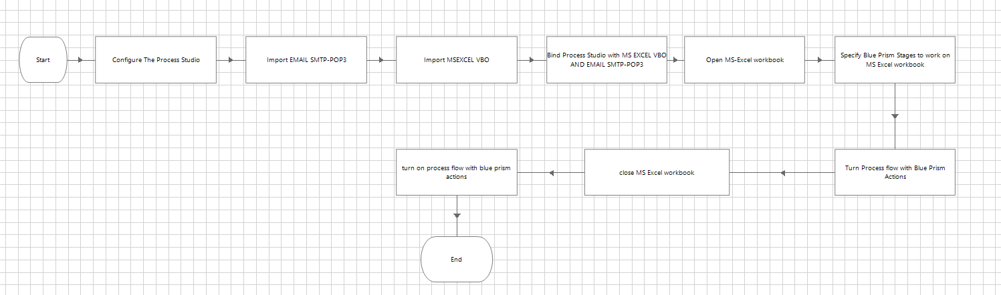
System Architecture / Ideation Map

Slide 8
HARDWARE REQUIREMENTS:
The following are the Hardware Requirements of the project
Internet connection to download and activate
Administration access to install and run Blue Prism
Minimum 10GB free disk space
Windows 8.1 or 10 (64-bit version only) OR Cloud: Get started free, *Cloud account required. Minimum System Requirements To run Office Excel 2013, your computer needs meet.
The following minimum hardware requirements:
500 megahertz (MHz)
256 megabytes (MB) RAM
1.5 gigabytes (GB) available space
1024x768 or higher resolution monitor

Slide 9
SOFTWARE REQUIREMENTS:
The following are the softwares required for the project:
Blue Prism software
Microsoft Excel 2013

Slide 10
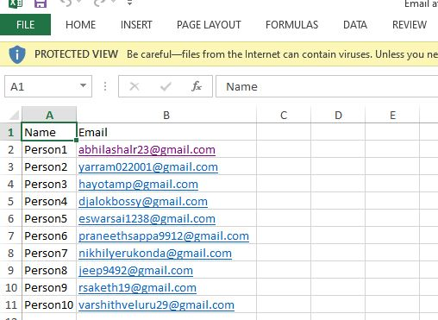
Constructions:
First store the name and email address of the people in Excel.

Slide 11
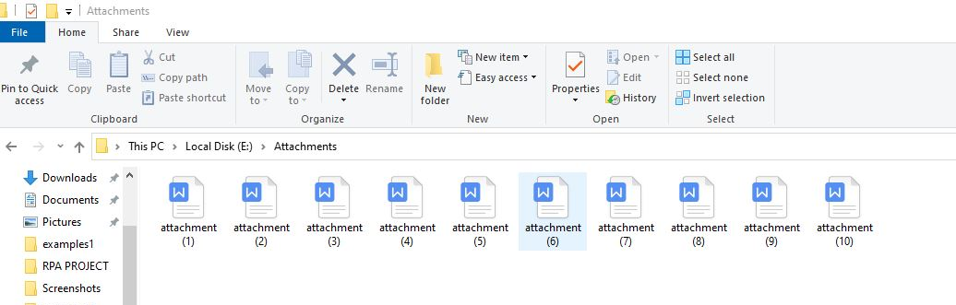
Store the attachment to add in email in a folder.

Slide 12
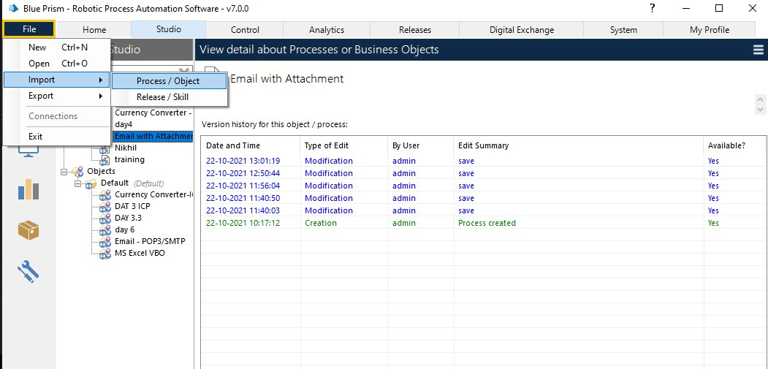
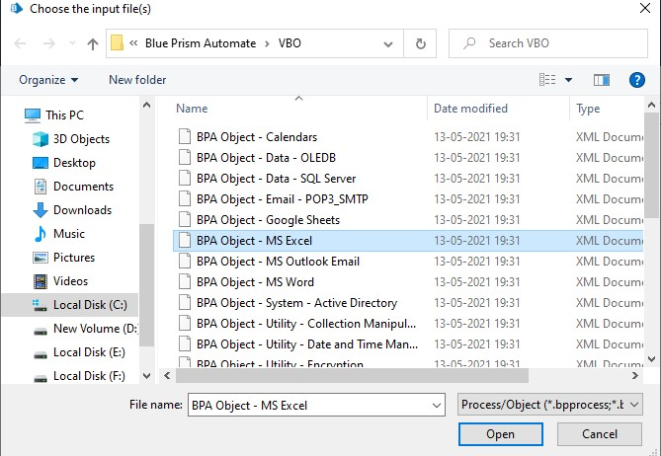
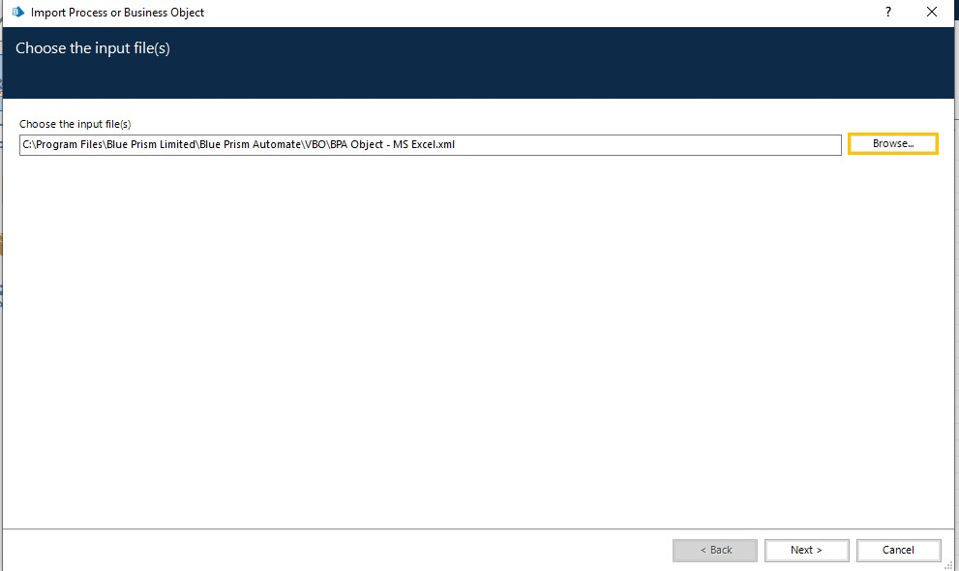
Milestone 1: Importing VBOs Step 1: MS Excel VBO (Import VBO file) File -> Import -> Browse -> (C:\Program Files\Blue Prism Limited\Blue Prism Automate\VBO\BPA Object - MS Excel). Click Finish.

Slide 13
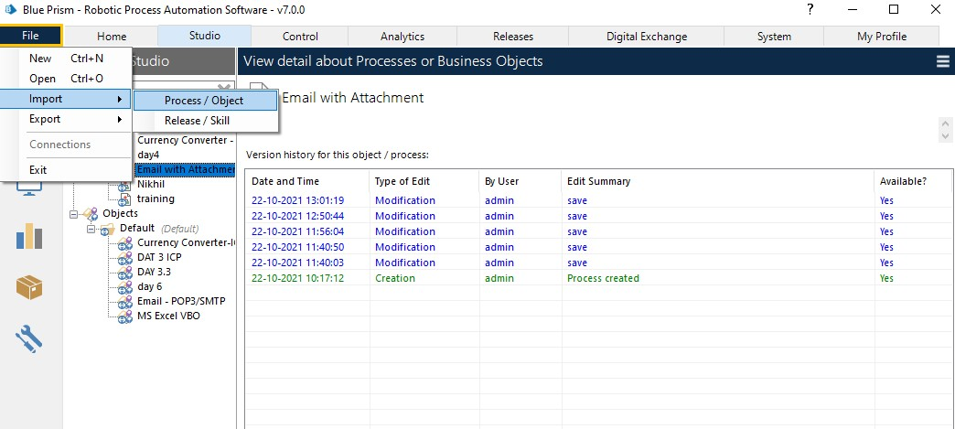
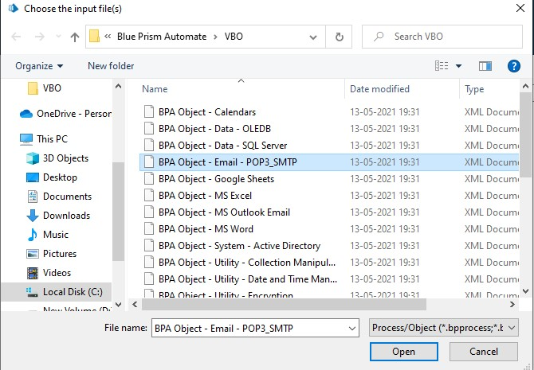
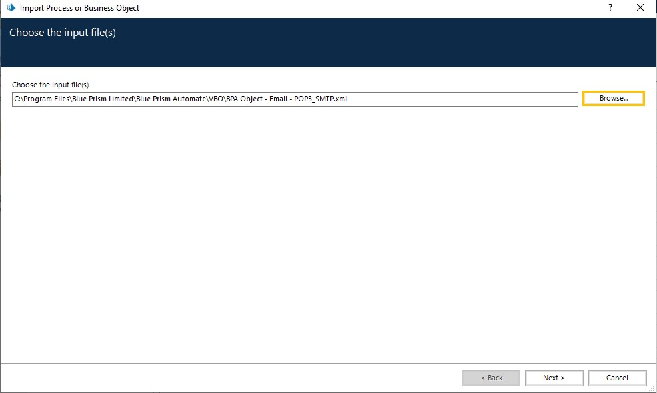
Step 2: Email VBO (Import VBO file) File -> Import -> Browse -> (C:\Program Files\Blue Prism Limited\Blue Prism Automate\VBO\BPA Object - Email). Click Finish

Slide 14
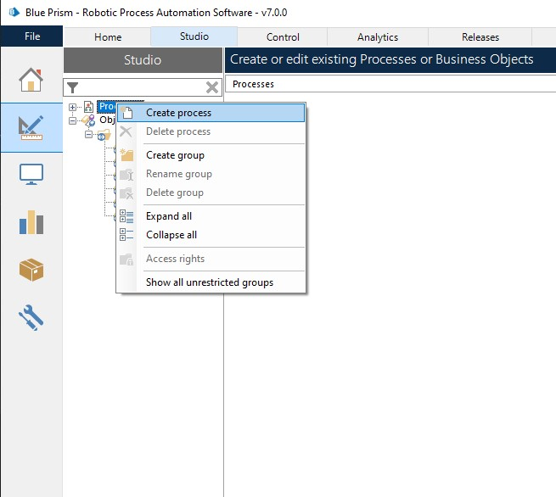
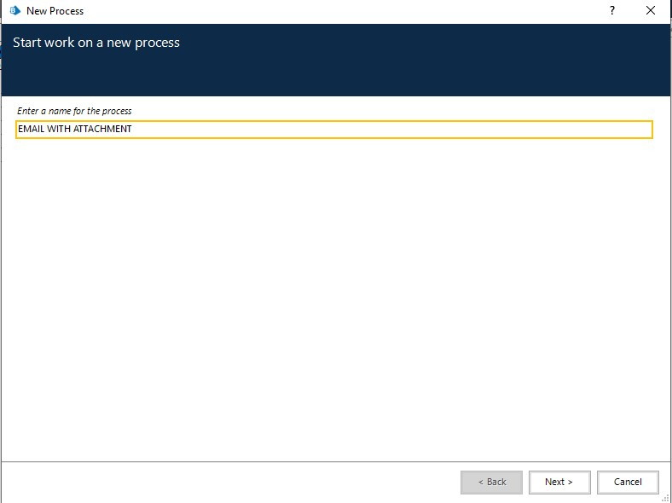
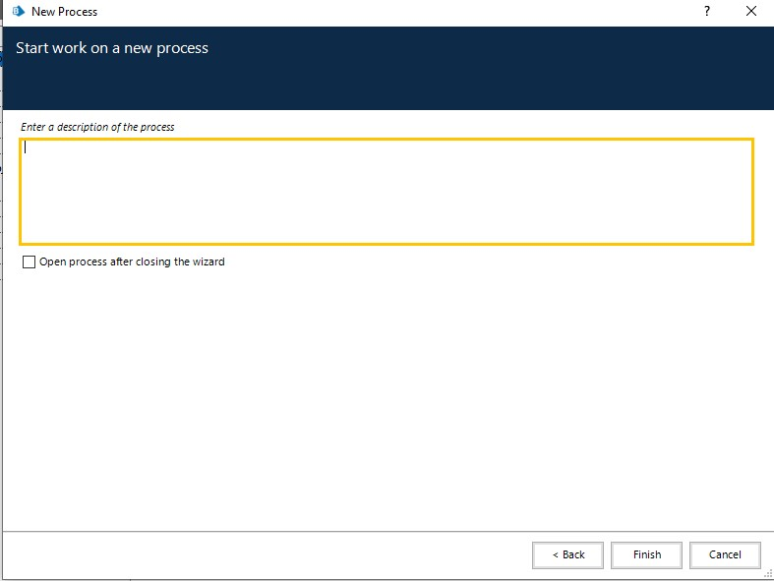
Milestone 2: Configure the process Step 1: Create a process After launching the Blue Prism, Open Studio tab, right-click on process, and select Create process.

Slide 15
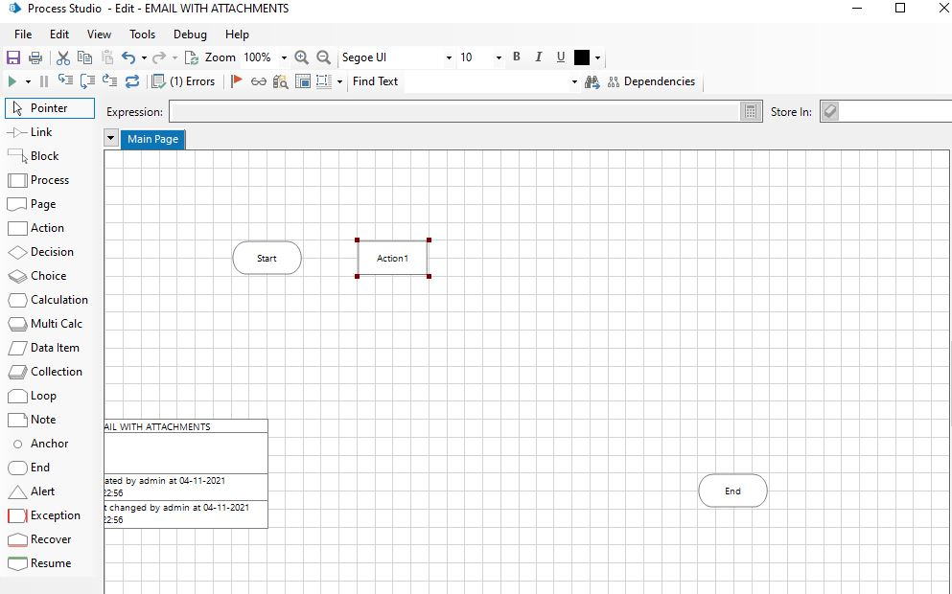
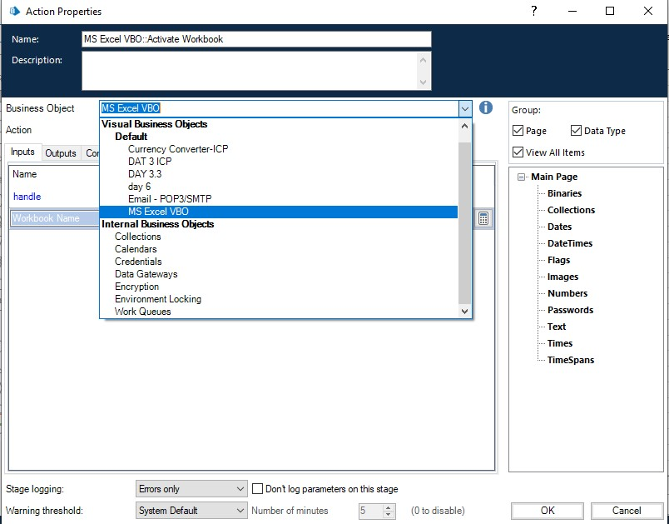
Step 2: Create an action stage, select MS Excel VBO from Business object drop down, select Create instance action. Create Data Item as follows, • type = number, • name =” handle”. Go to output tab and drag it into Store In column, click on ok

Slide 16
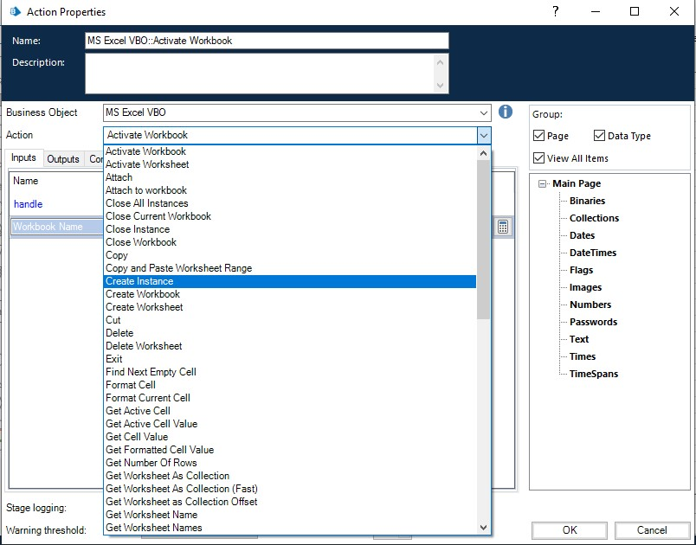
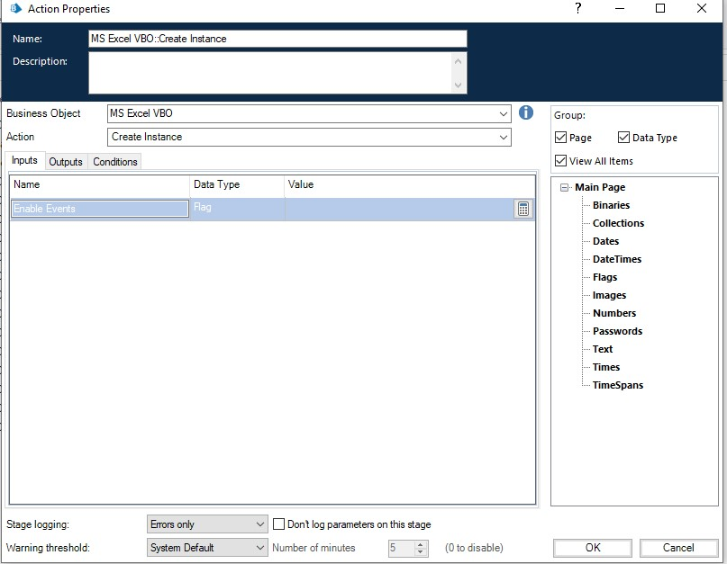
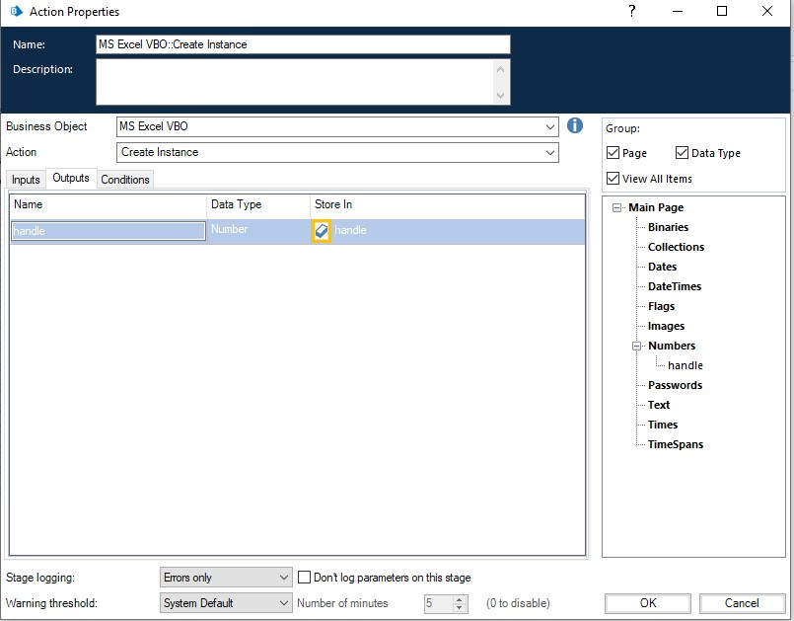

Slide 17
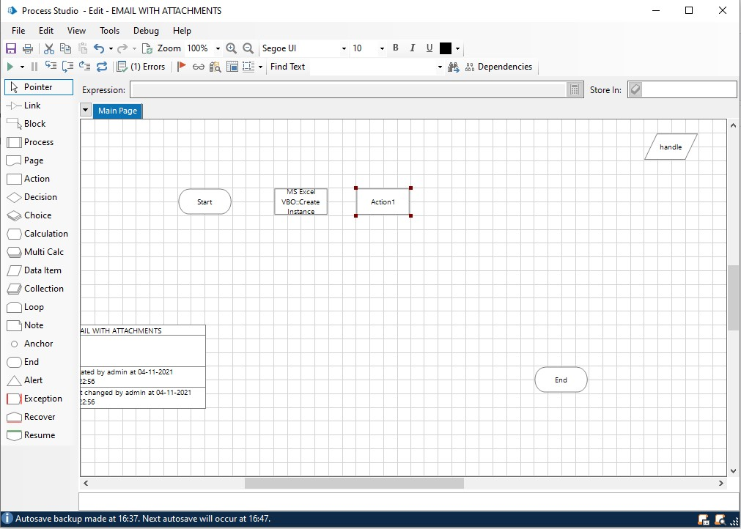

Step 3: Create an action stage, select MS Excel VBO from Business object drop down, select Open Workbook action.
Create Data Item as follows,
• type = text; name =” Workbook name”.
Go to output tab and drag it into Workbook Name column, click on ok.
In the input tab give the handle and path of the excel file

Slide 18
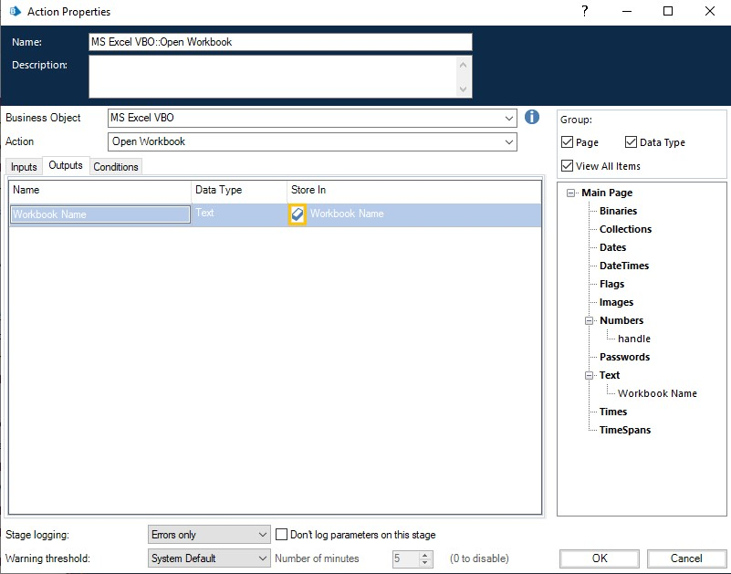

Slide 19
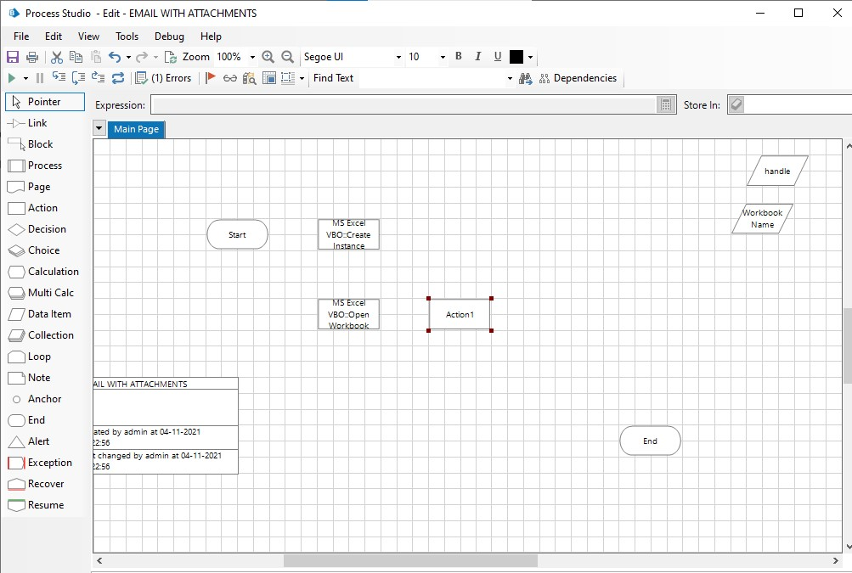
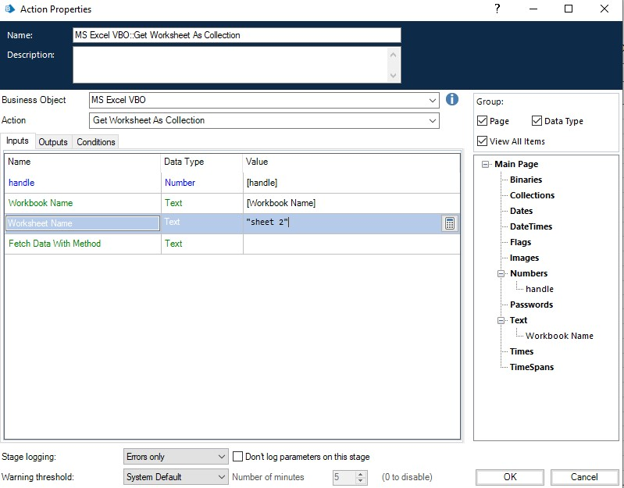
Step 4: Create an action stage, select MS Excel VBO from Business object drop down,
select Get worksheet as collection.
Create Collection with fields as follows,
• type = text; name =” Name”
• type = text; name= “Email”.
Go to output tab and drag it into Workbook Name column, click on ok.
In the input tab give the handle, workbook name and name of sheet in excel file

Slide 20

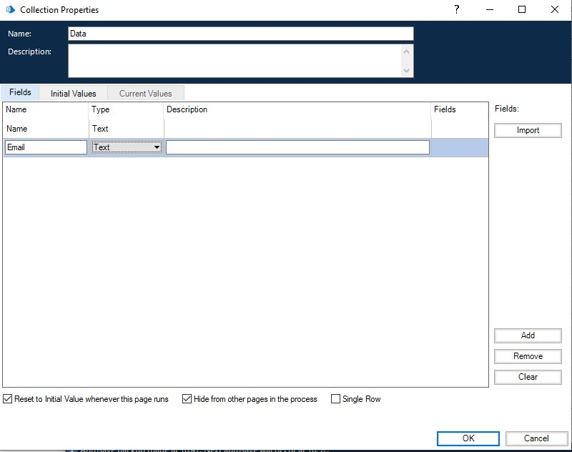

Slide 21
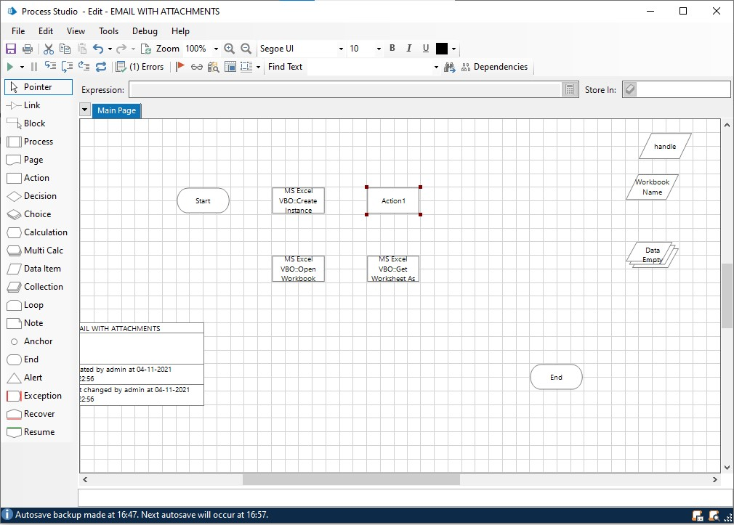
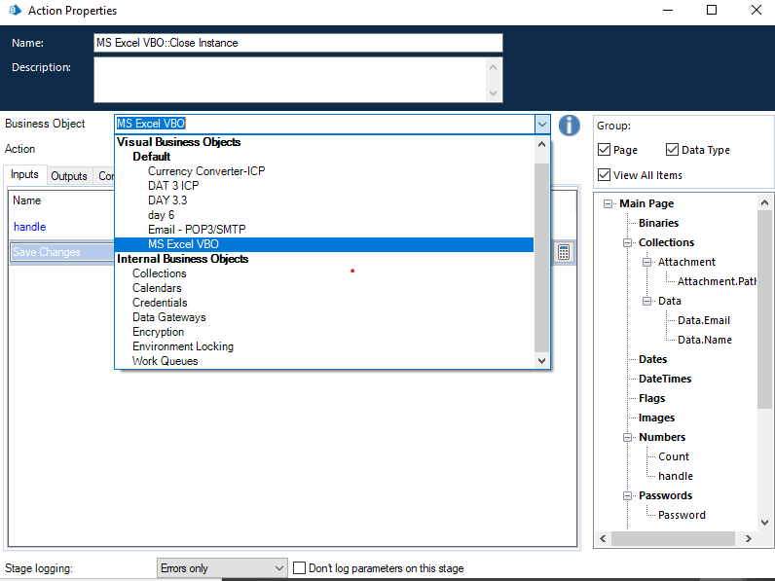
Step 5: Create an action stage, select MS Excel VBO from Business object drop down,
select Close Instance action Drag and drop the handle, give the file name, click on ok.

Slide 22
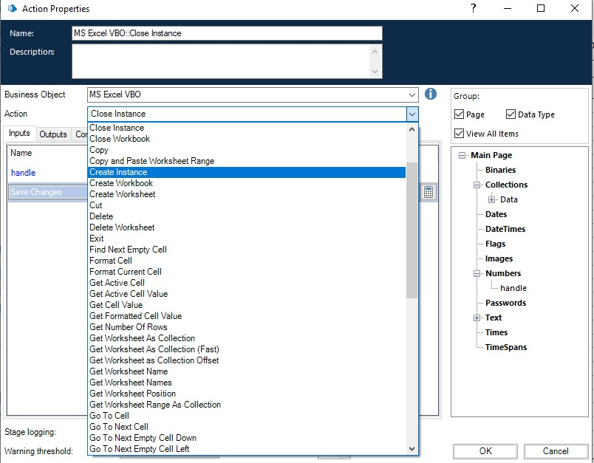
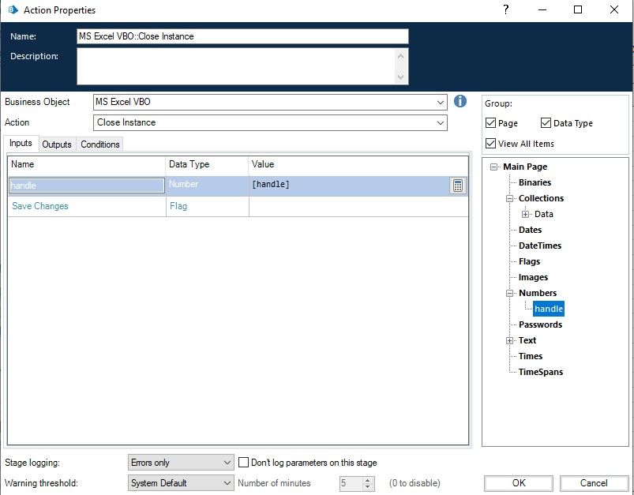

Slide 23
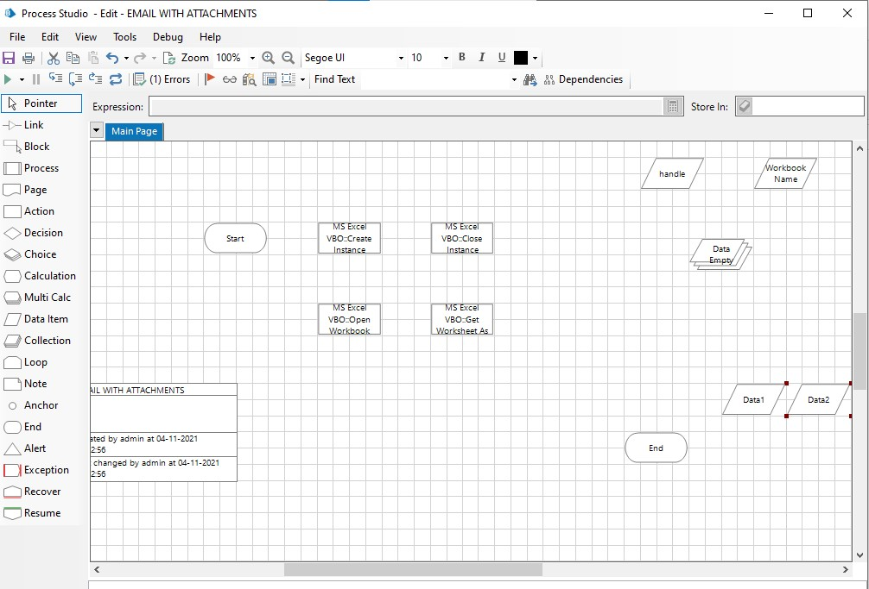
Step 6: Add two data items
1.To store the Email
• Name – Email
• Type – Text
• Initial value – Your email ID
2. To store the Password
• Name - Password
• Type – Password
• Initial value – Password of your email ID

Slide 24
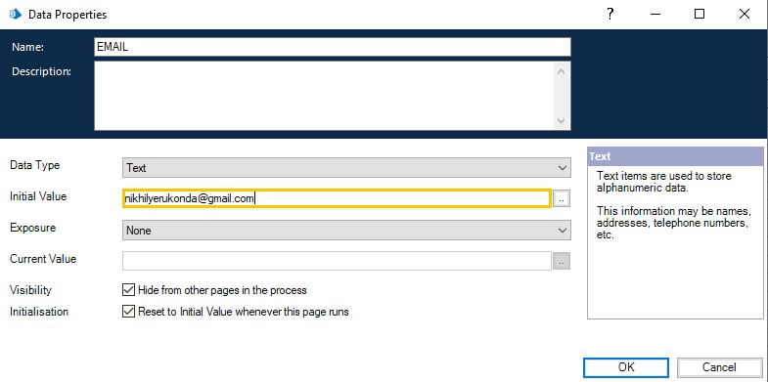
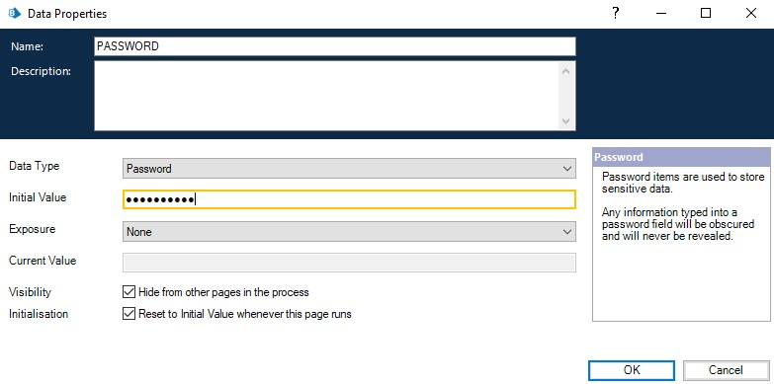

Slide 25
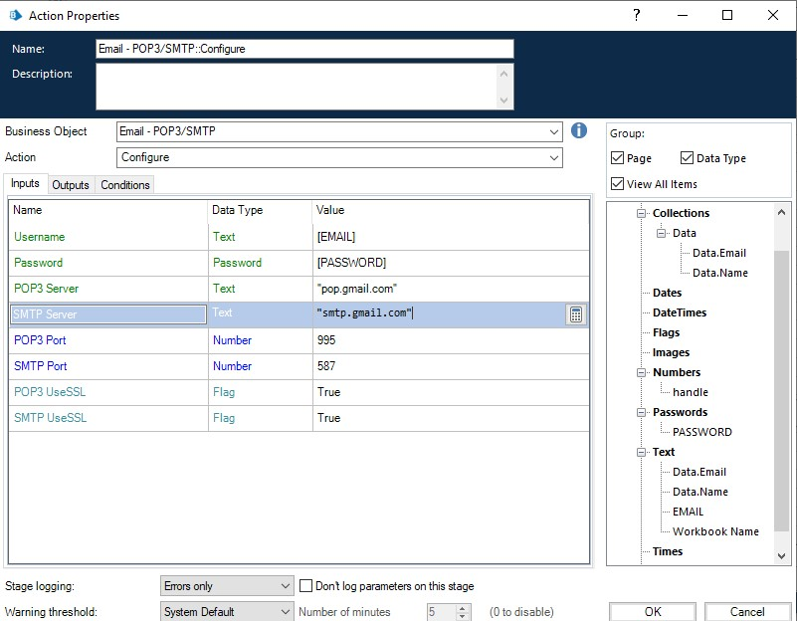
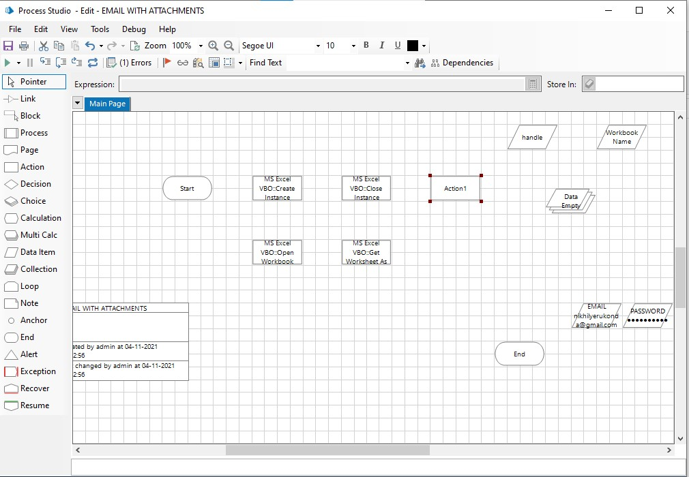
Step 7: Create an action stage, select Email VBO from Business object drop down, select Configure action.
In the input tab give the Email and Password and the give the following details:
• POP3 Server = "pop.gmail.com"
• SMTP Server = "smtp.gmail.com"
• POP3 Port = 995
• SMTP Port = 587
• POP3 UseSSL = True
• SMTP UseSSL = True
Click on ok.

Slide 26
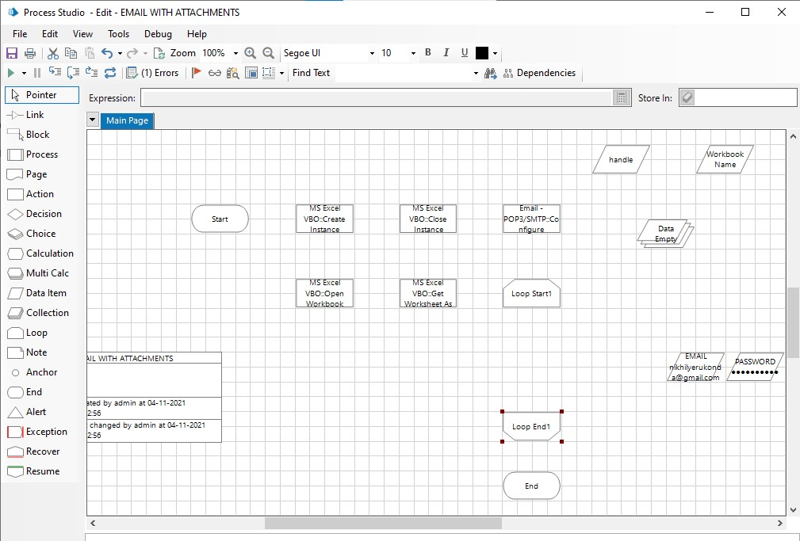
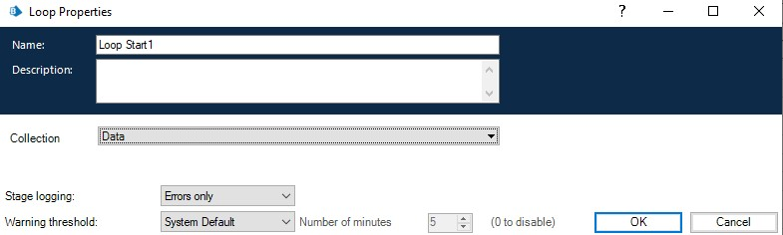
Step 8: Add a loop stage and make it to loop for Data collection.
Drag and drop a loop stage and change the arrangement of all the stages in the page, double click on it and in the collection drop down select data collection

Slide 27
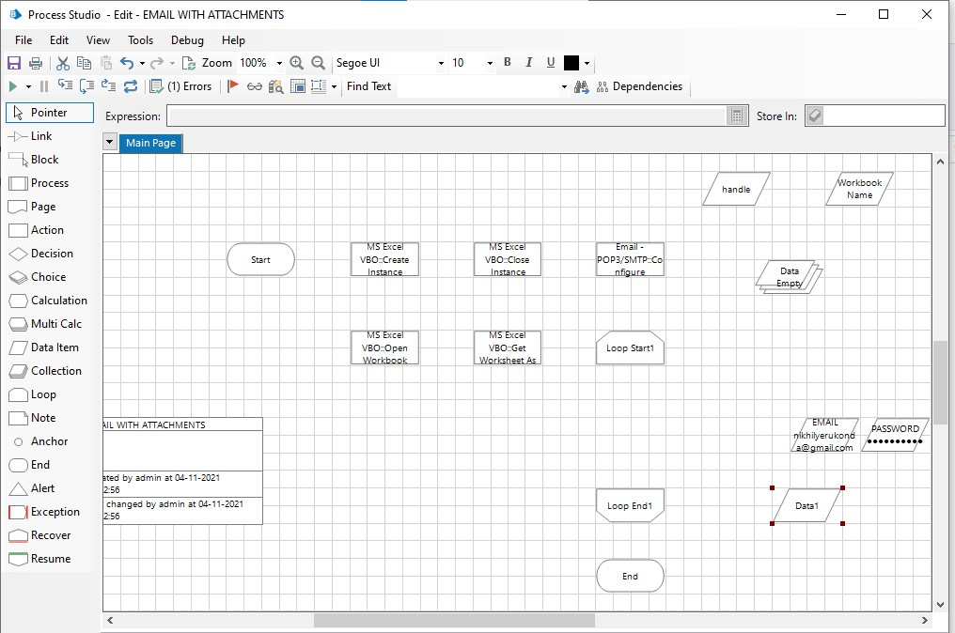

Step 9: Add two data items
1.To store the path of the attachment (only the constant path. For the numerical part we will be using
calculation stage.
• Name – Path
• Type – Text
• Initial value – constant values in the attachment path.
2. To store the number to increment the path for each attachment
• Name – Count
• Type – Number
• Initial value – 1

Slide 28
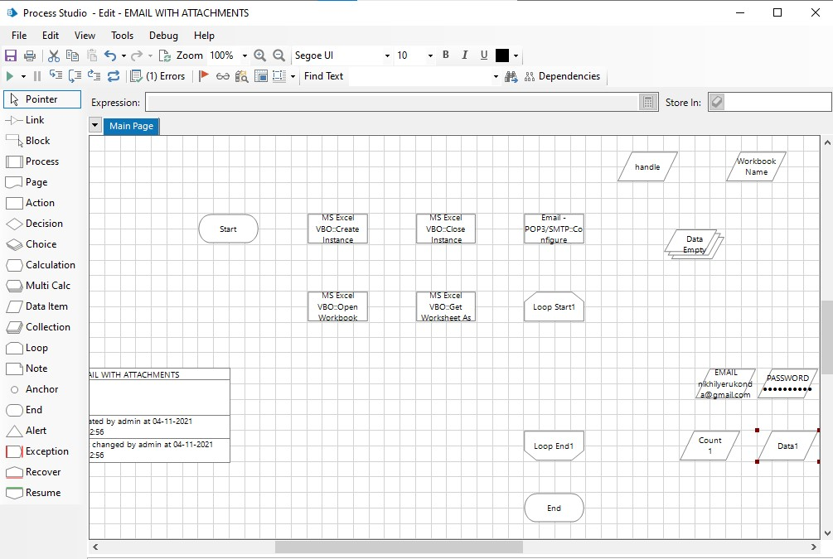


Slide 29
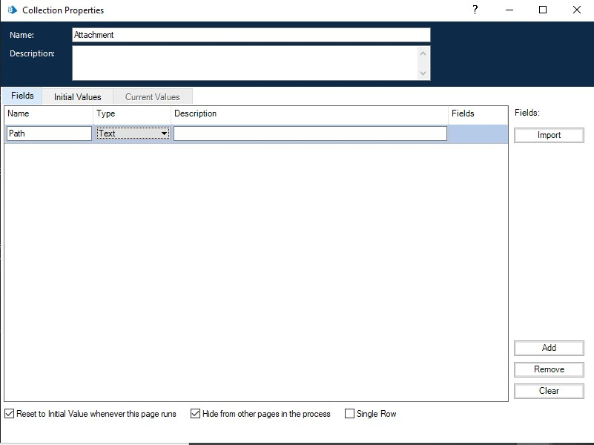
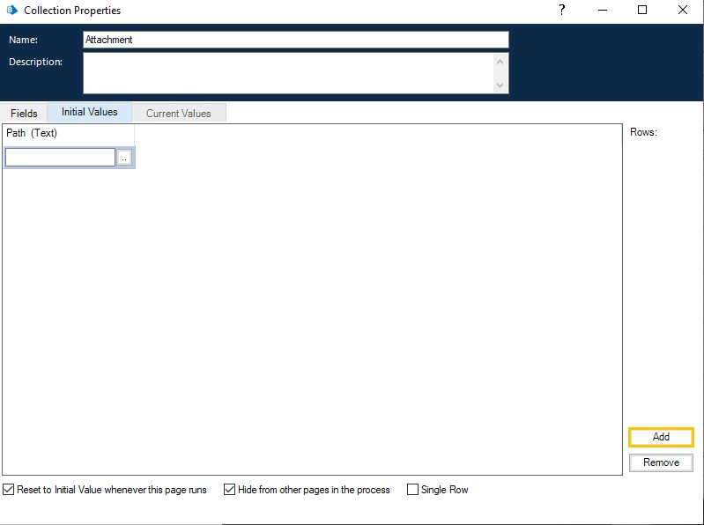
Step 10: Drag and drop a collection, rename it as Attachment and give the following as initial fields
• Name – Path; type – Text
• Create a row in initial values column.

Slide 30
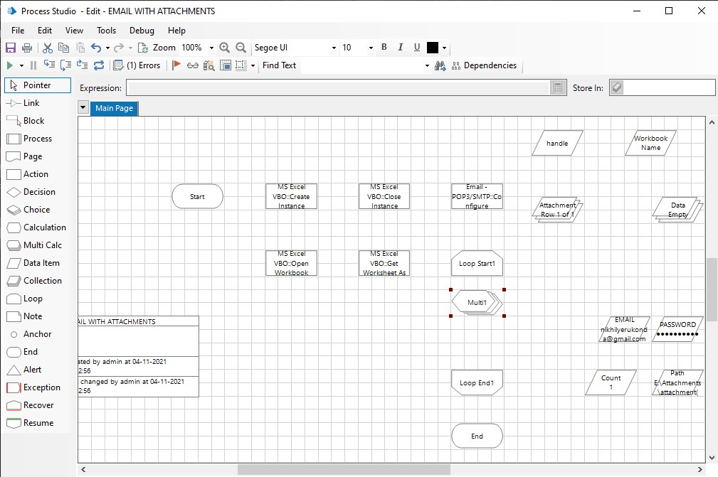
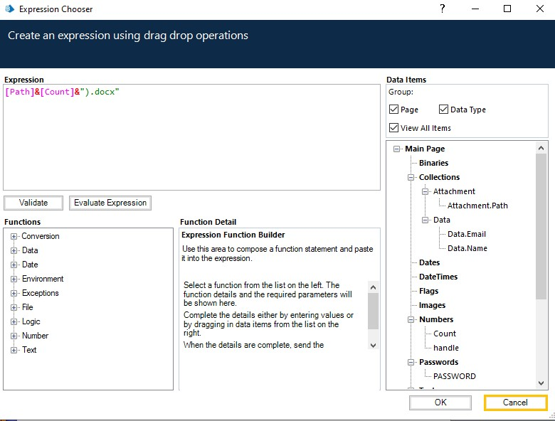
Step 11: Add a multi calculation stage to store the path to Attachment collection and to calculate path.
Drag and drop a multi calculation stage, double click on it and add the following:
• Calculate the path and store it in Attachment collection.
• Increment count

Slide 31
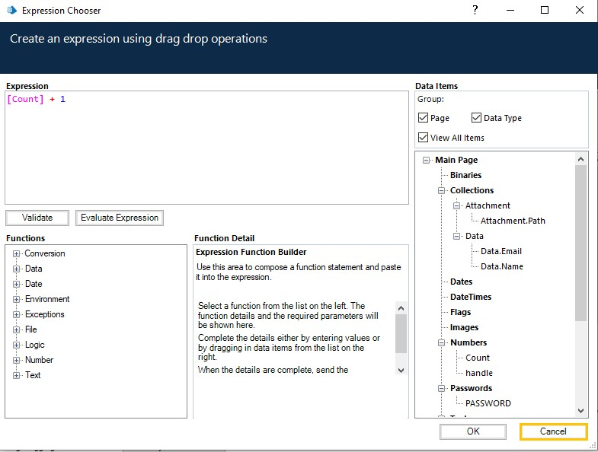
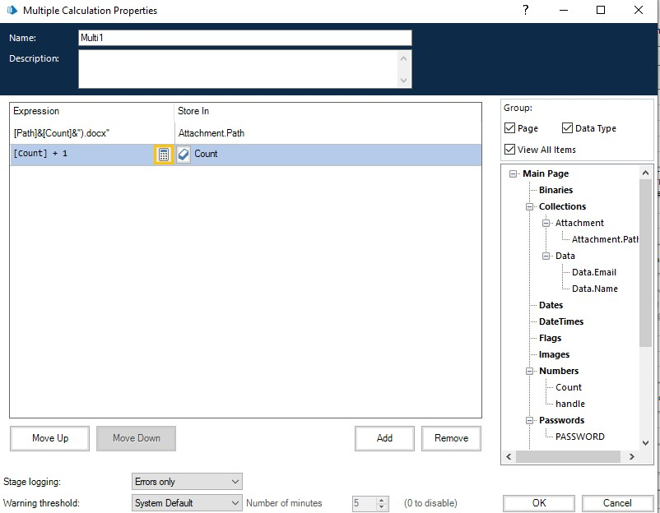

Slide 32
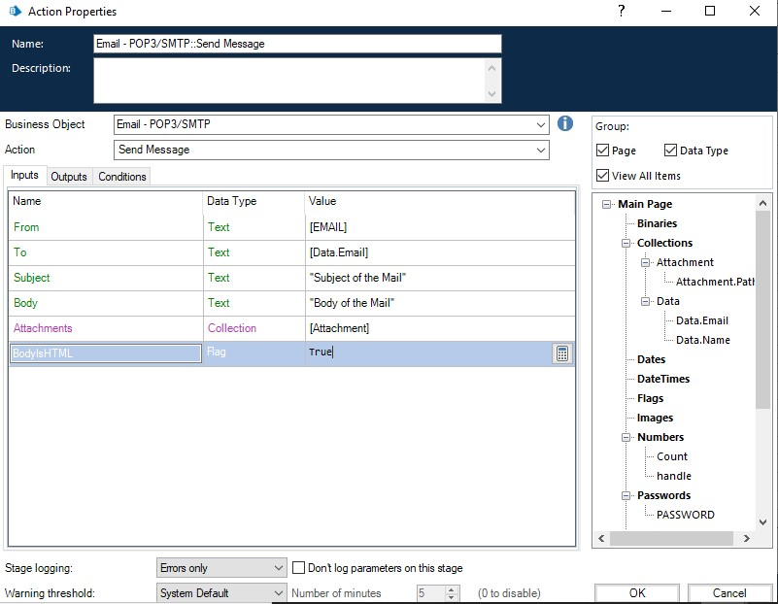
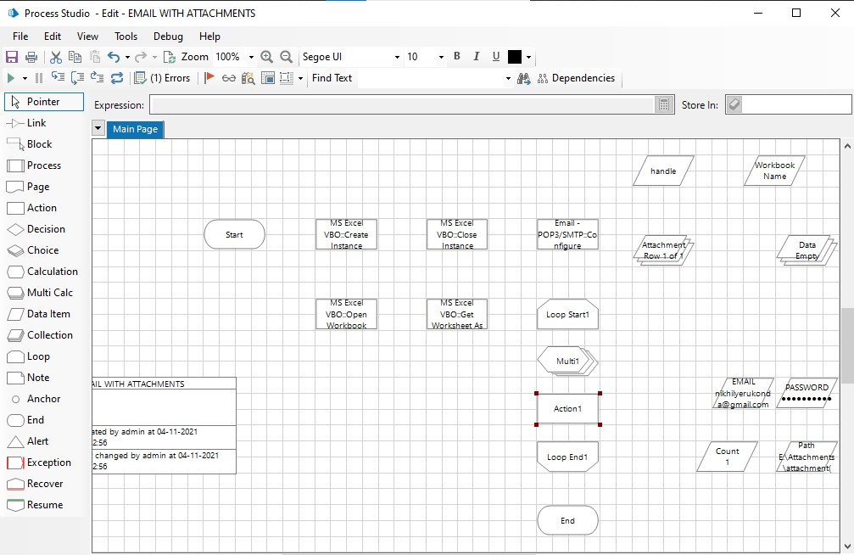
Step 12: Create an action stage, select Email VBO from Business object drop down, select Send message action.
In the input tab give the following details:
• From = Email data item
• To = Email from data collection
• Subject = The subject you want to send
• Body = The body you want to send
• Attachment = Attachment collection
Click on ok.

Slide 33
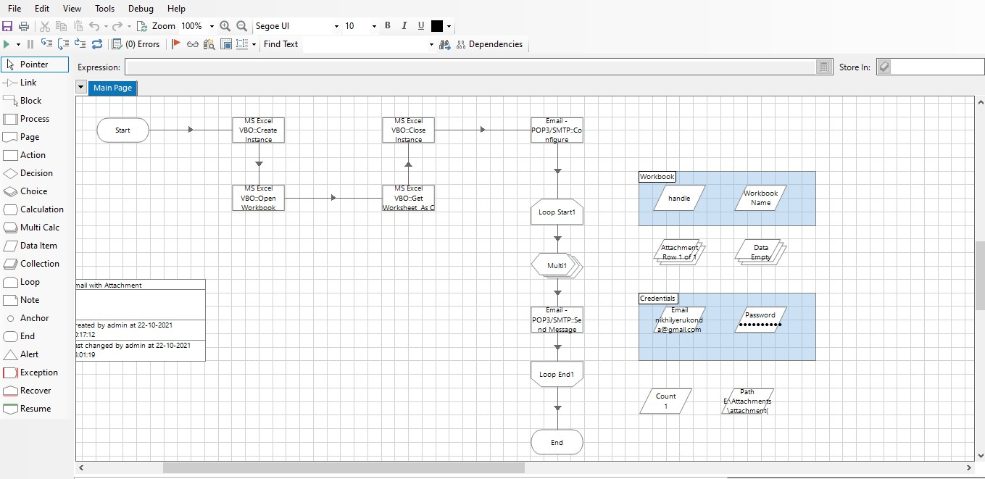
Step 13: Link all the stages and run the bot at different timings to notice getting login to different classes.
Do Proper connections (Links)

Slide 34
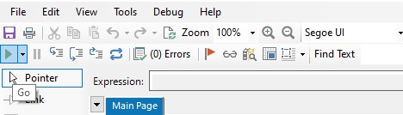
Step 14: Testing the Process Object from Object Studio Click on Main Page, click on the Green play button to run the ‘Web Automation T2 Process’ Process object. It shows COMPLETED when there is no error or no failure in the object.

Slide 35
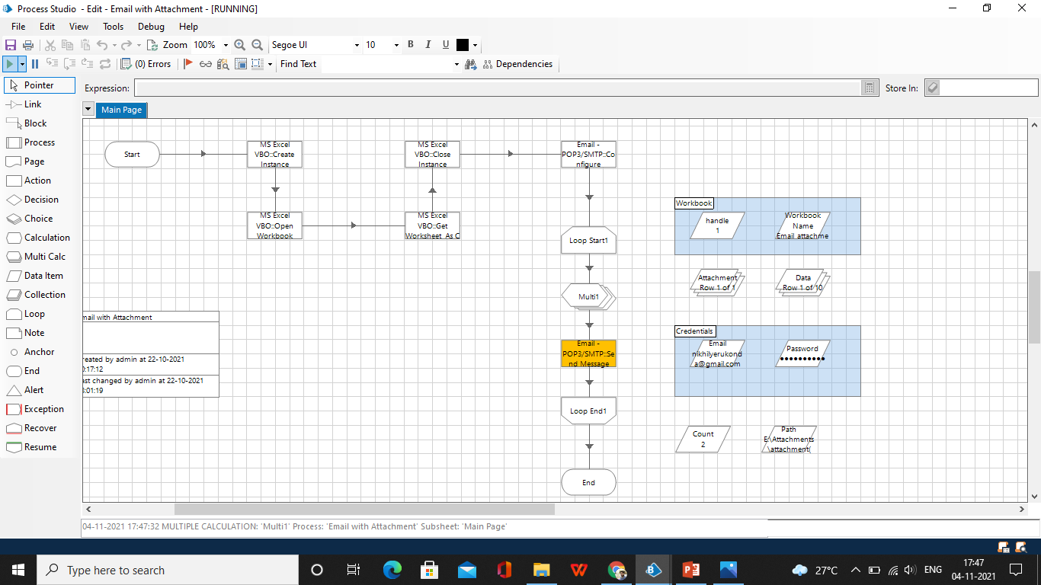
Output:

Slide 36
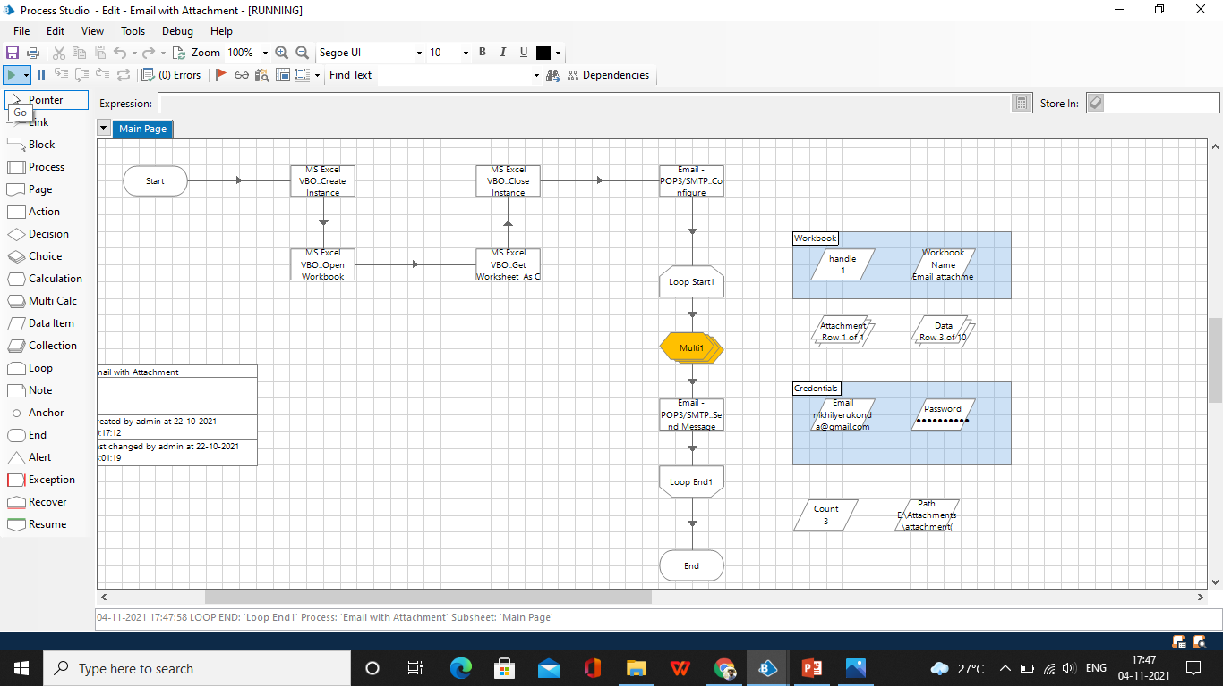

Slide 37
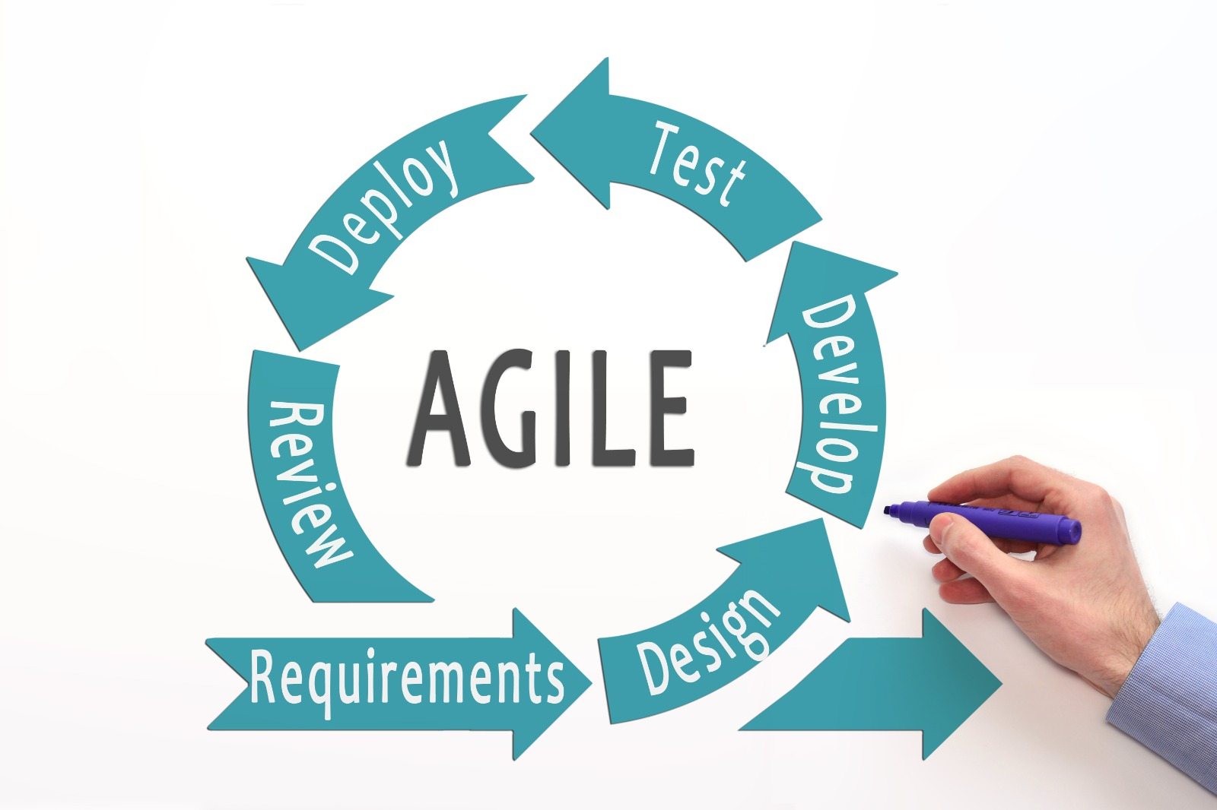
Methodology:

Slide 38
Requirements:
We need to launch blue prism software is one of the technology of RPA.We need to have
MS EXCEL SHEET
PC WITH 64 BIT
DESIGN:
We need to import MS-EXCEL VBO and EMAIL SMTP Tuning process studio with specific need to build a bot. That automatically send messages
DEVELOP:
In this stage we need to develop the process studio with different stages that are required
○ Create Instance
○ Open Excel file
○ Getting email IDs
○ Closing Excel file
○ Configuring Email
○ Fetching attachments
○ Sending mails

Slide 39
TEST :
After completion of develop stage we need to run the process and test the output.
If we need any update in the output or any correction just we can go to develop stage and we can change the stages.
DEPLOY:
In this stage we can update and change the stages in the development so that we can get the correct output according to the users.
REVIEW:
The entire project has to be reviewed and get feedback from the people who are using this.
Finally we have to launch the project.

Slide 40
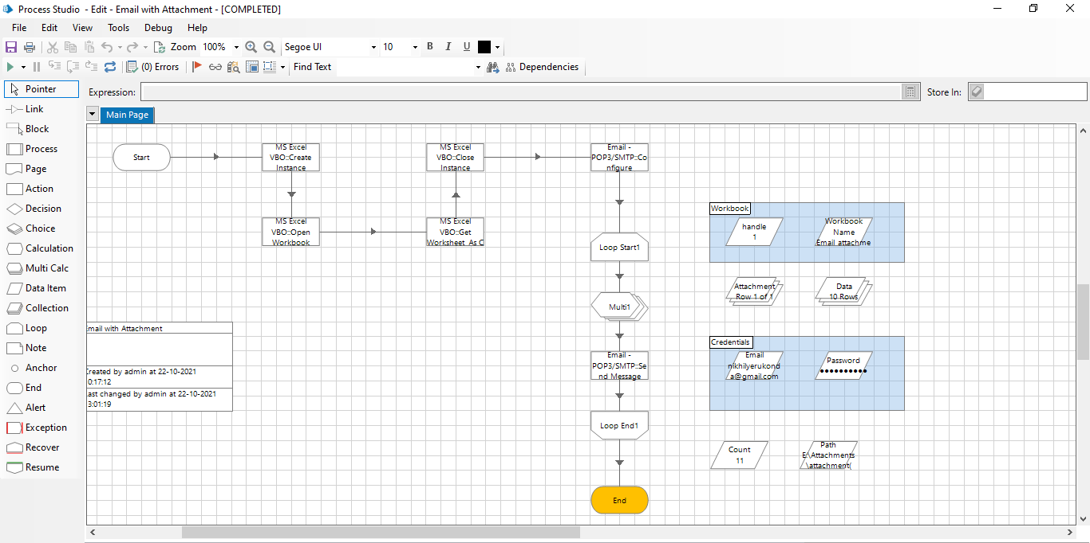
Result and Discussion:

Slide 41
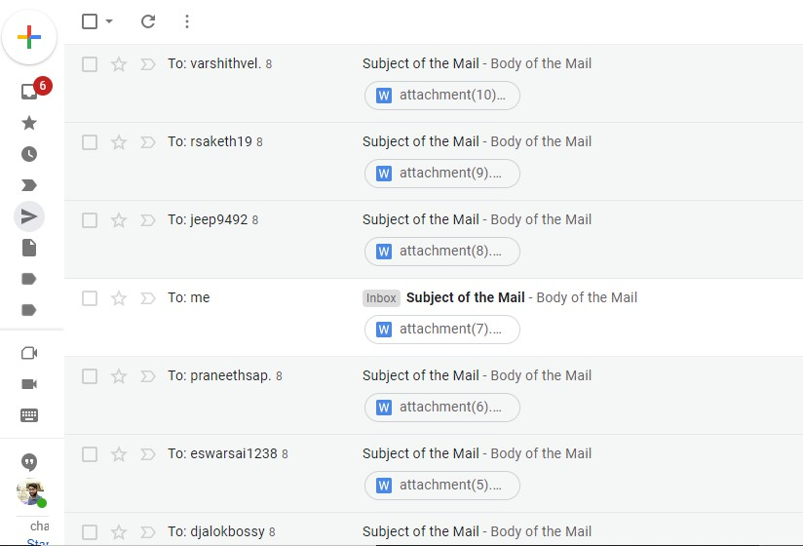
From the above picture mails are send successfully with attachments.
This process makes more efficient and we got the accurate results
Email automation is now a digital marketing staple, replacing the tedious task of manually sending emails to every customer with preconfigured workflows. You can specify what communication should be triggered in response to each customer’s behavior. This lets you map a variety of customer journeys and ensure optimum engagement with your brand.

Slide 42
Conclusion
Conclusion Statement of the Project
From this project I get to know that Email automation very important for any other developments also. At first we have to store the each person email id in Microsoft Excel and save it for further use. We have to import MS-EXCEL VBO and Email SMTP-POP3 VOB into the Blue Prism, and then create the process and then we have to give the following actions such as create instance, opening excel file, getting email id's, closing the excel file,Configuring Email,fetching the attachments and then sending the mails. Click on refresh button then click run button to run the program. The resultant output will be emails sent with the attachment
Future Scope:
In future there will be many development takes place under this email automation.Email marketing can be further develop by this technique.this email is the top tool used by 90 % of the population.

Slide 43
References
M. Lacity, L. P. Willcocks, & A. Craig.Robotic process automation at Telefonica O2.The Outsourcing Unit Working Research Paper Series, 2015
IRPA, “Introduction To Robotic Process Automation,” tech. rep., 2015.
H. P. Fung "Criteria, use cases and effects of information technology process automation (ITPA)." Advances in Robotics & Automation 3 (2014).
Dana Nau, Malik Ghallab, and Paolo Traverso Automated Planning: Theory & Practice. Morgan Kaufmann, 2014.
M. Barrett, E. Oborn, W. J. Orlikowski, and J. Yates, “Reconfiguring 4Relations: Robotic Innovations in Pharmacy Work ,” Organ. Sci., vol. 23, pp. 1448– 1466, 2012.

